Slide 1
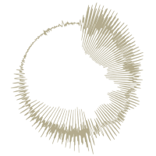
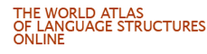
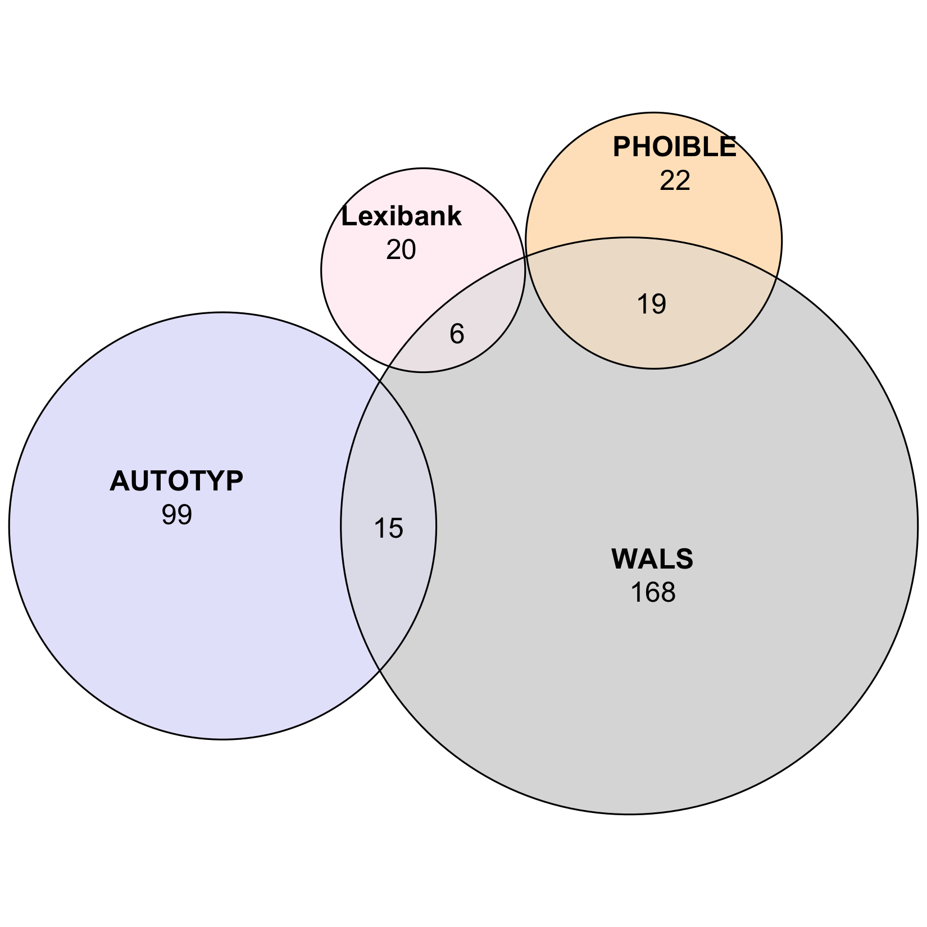
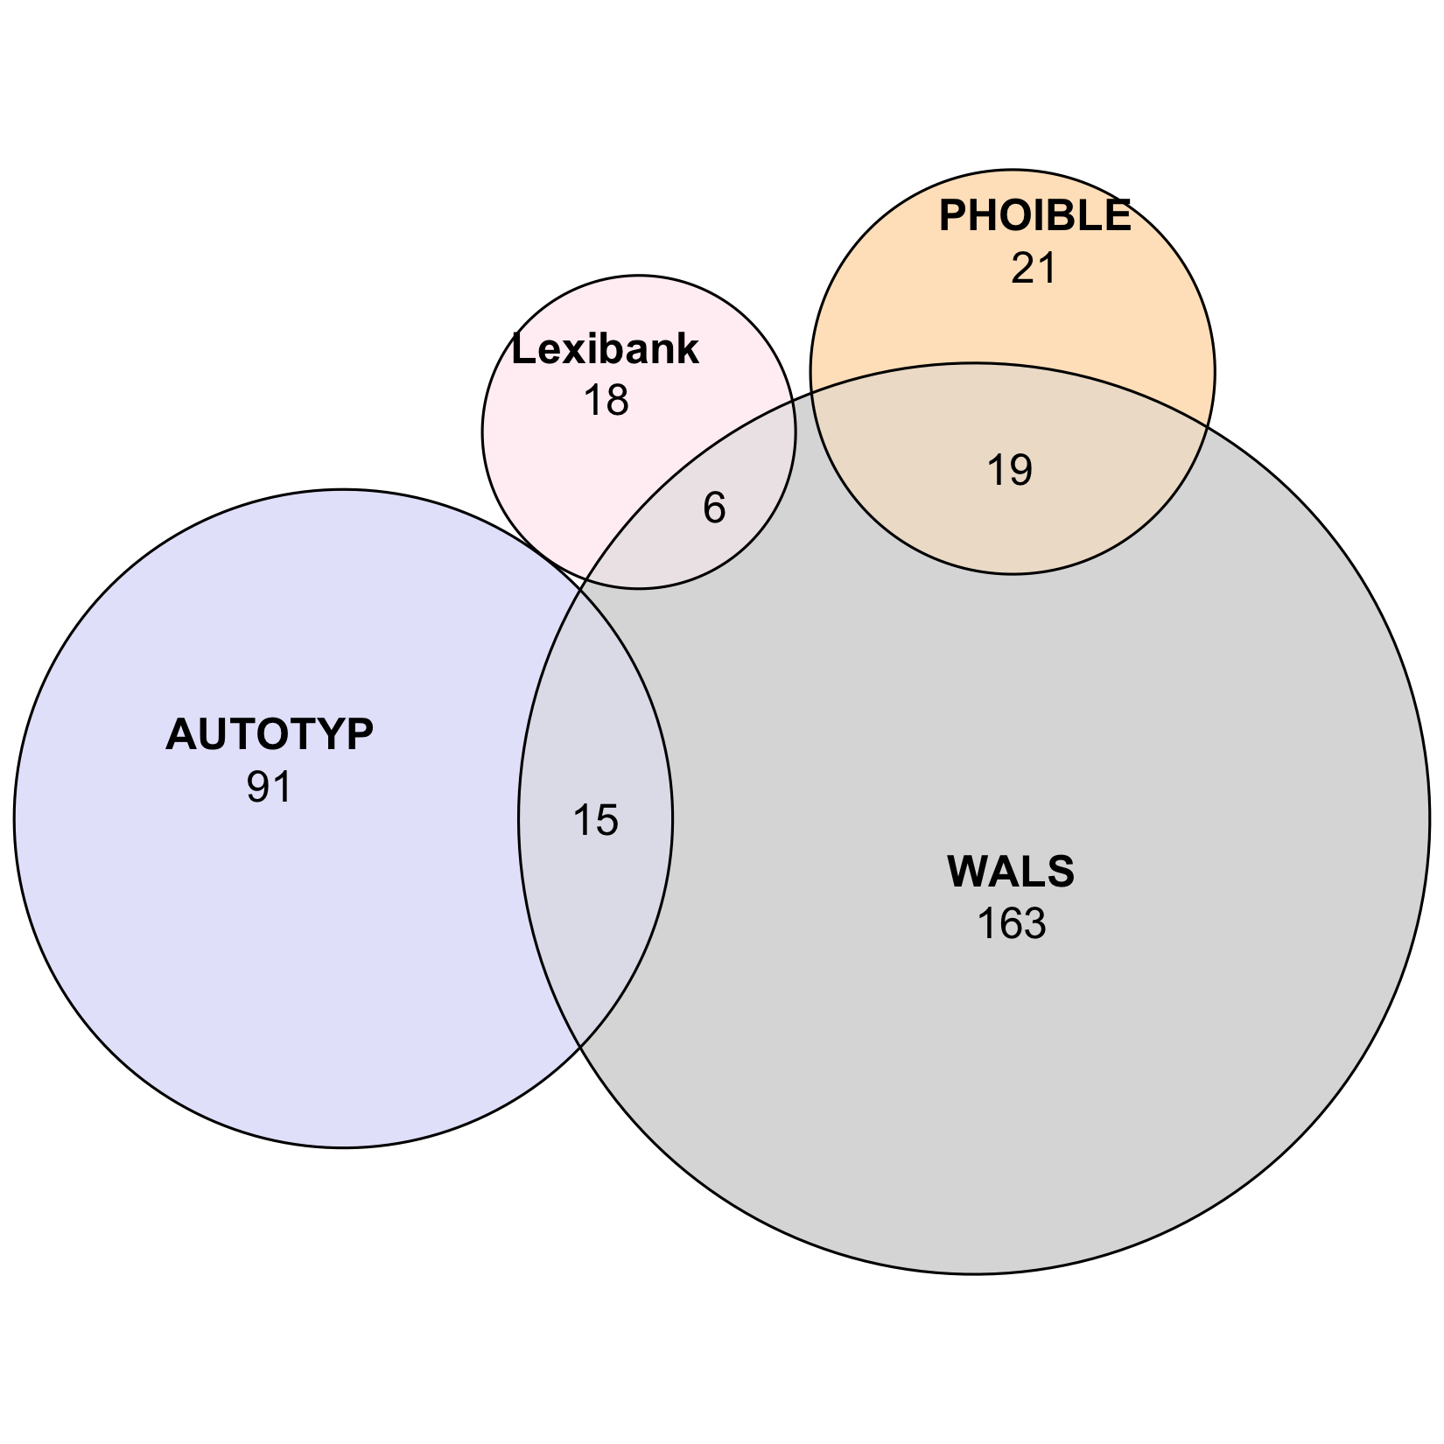
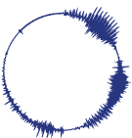

A. GBInd
GBInd logical,
pruned:
190 features
1,229 languages
GBInd statistical,
pruned:
181 features
1,144 languages
densify
densify
Step 1
feature design +
logical independence
Step 2
statistical independence*
Grambank:
195 features
2,467 languages
GBInd logical:
203 features
2,467 languages
GBInd statistical:
196 features
2,467 languages
95 retentions
100 exclusions
108 merges/modifications
158 retentions
45 exclusions
38 merges/modifications
inputs
curated outputs
WALS:
192 features
2,501 languages
Step 1
feature design +
logical independence
Step 2
statistical independence*
TypLinkInd logical:
349 features
4,259 languages
TypLinkInd statistical:
333 features
4,257 languages
102 retentions
736 exclusions
247 merges/modifications
300 retentions
49 exclusions
33 merges/modifications
AUTOTYP
AUTOTYP:
545 features
1,126 languages
Lexibank:
60 features
2,029 languages
PHOIBLE:
41 features
2,176 languages
densify
densify
densify
densify
B. TypLinkInd
TypLinkInd logical,
pruned, large:
344 features
1,677 languages
TypLinkInd logical,
pruned, small:
335 features
555 languages
TypLinkInd statistical,
pruned, large:
328 features
1,696 languages
TypLinkInd statistical,
pruned, small:
321 features
644 languages

